Slide 1

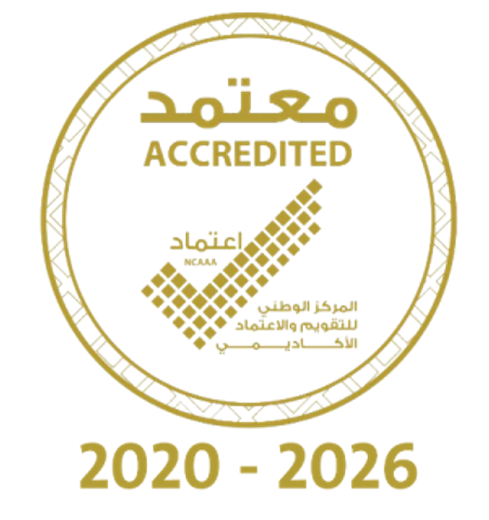
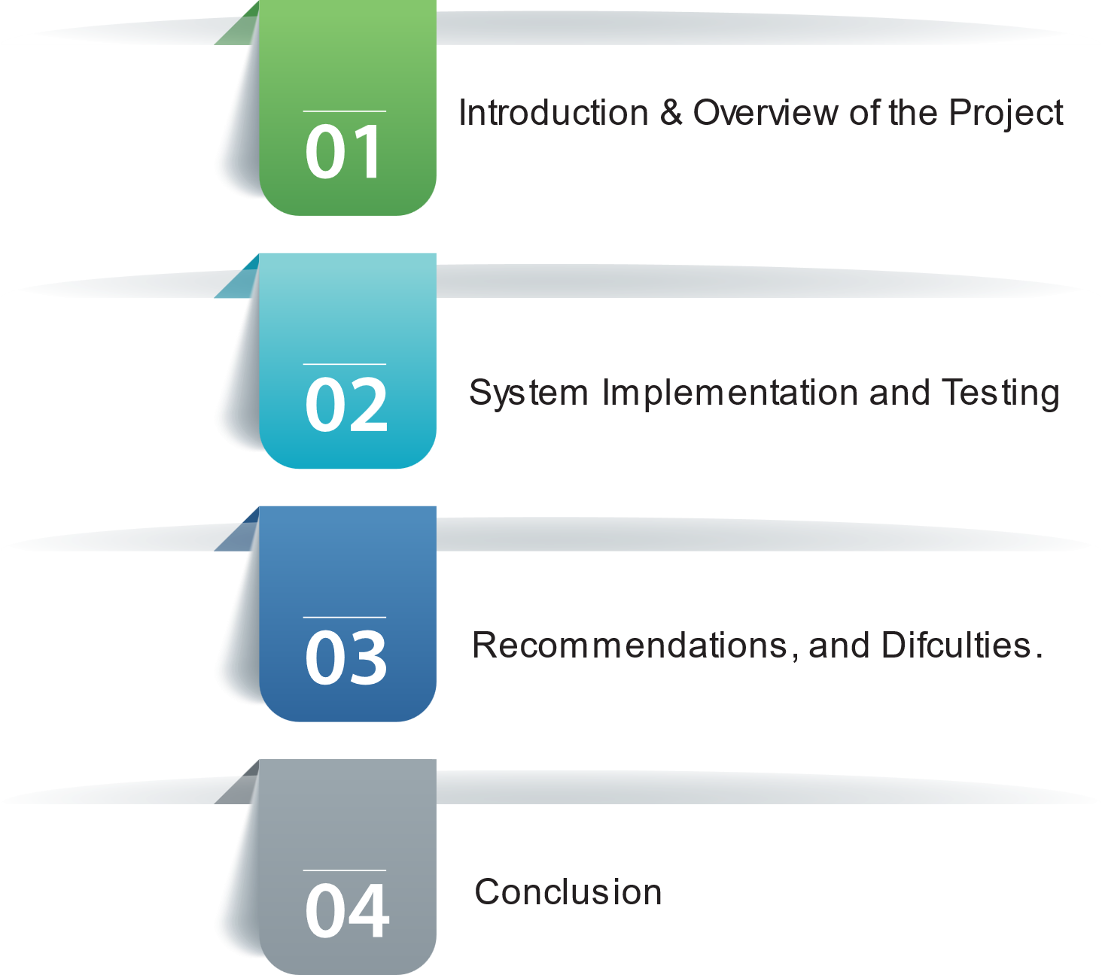

Saleh Mohammed Alanazi Mousa Mohammed Bariqi Sultan Yahya Alawaji Esam Muftin Alotaibi
A Prediction Model-Based Application to forecast the Attainment of the Programs' Learning Outcomes (PLOs) at the University of Tabuk (UoT)
Supervisor: Dr. Awad M. Awadelkarim

Slide 2

Outlines:

Slide 3



[10:08 PM]
[10:08 PM]
[10:08 PM]
[10:08 PM]
[10:08 PM]
Introduction & Overview of the Project
The system aims to identify students at risk of failure and improve learning outcomes achievement.
Academic institutions face significant challenges in enhancing and assessing the attainment of the PLOs.
Learning outcomes encompass knowledge and skills expected to be acquired by students.
The improvement initiative aims to meet market demands and prepare graduates more effectively.
Failure to align with the job market adequately may result in a shortage of qualified workforce, negatively impacting the national economy.
1

Slide 4
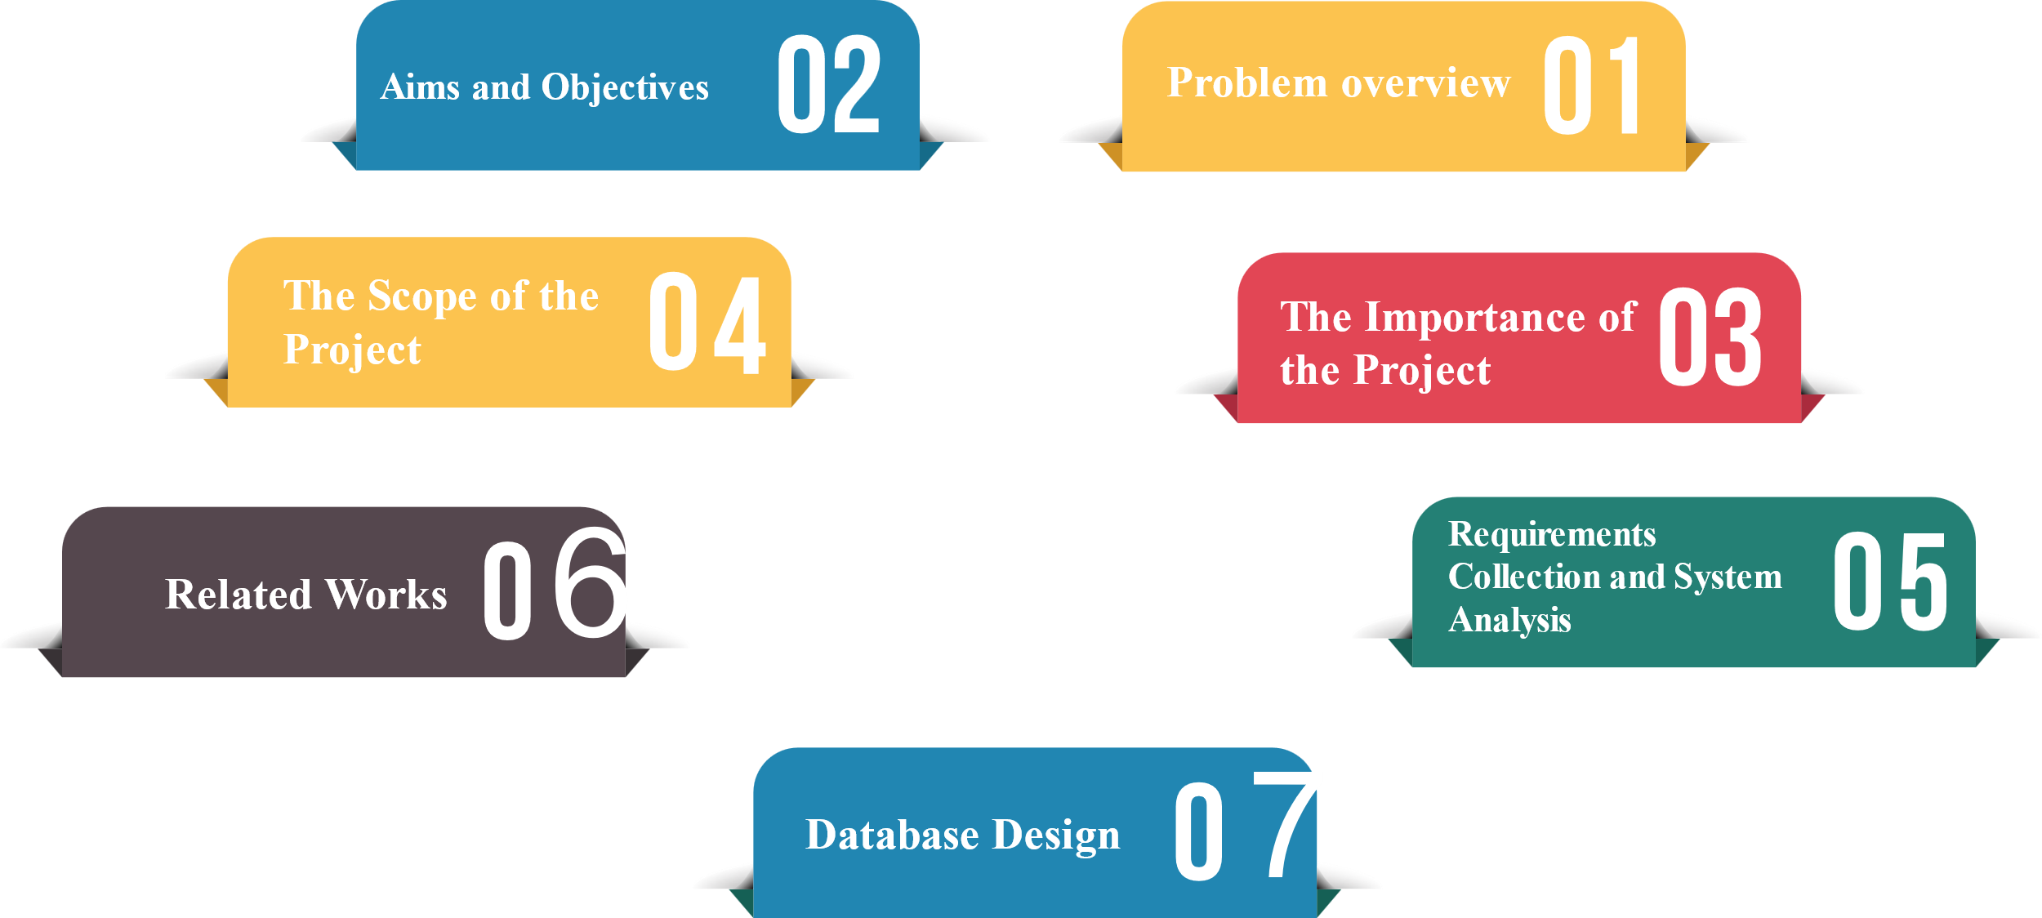
Introduction & Overview of the Project
2

Slide 5

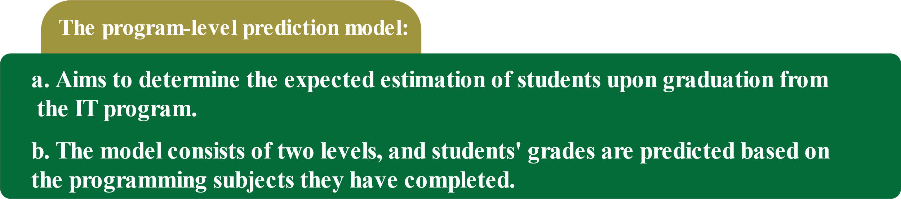





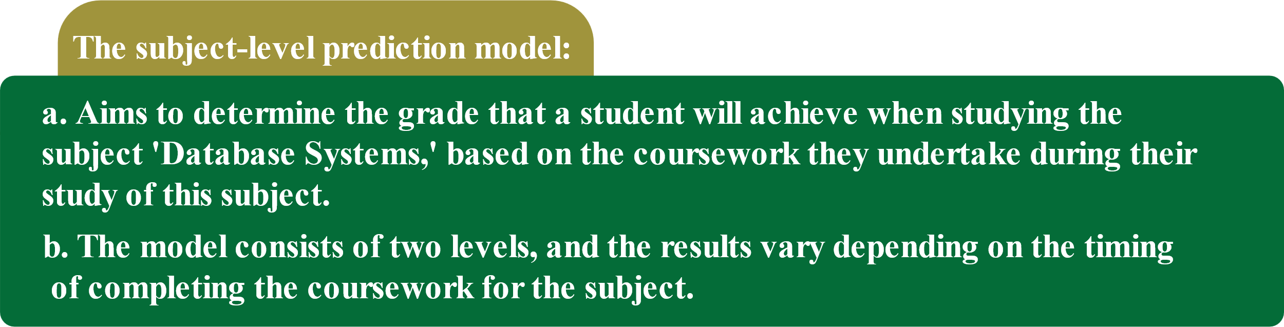

System Implementation and Testing
3

Slide 6
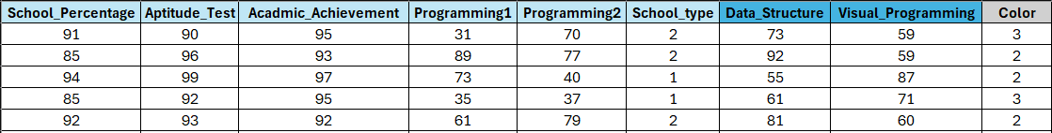
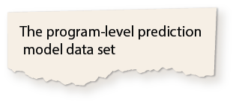
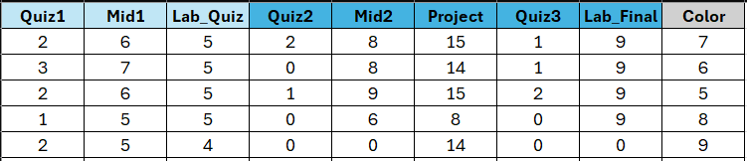
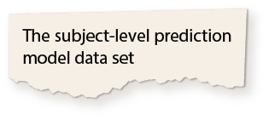
System Implementation and Testing
4

Slide 7
System Implementation and Testing
Login Interface
5

Slide 8
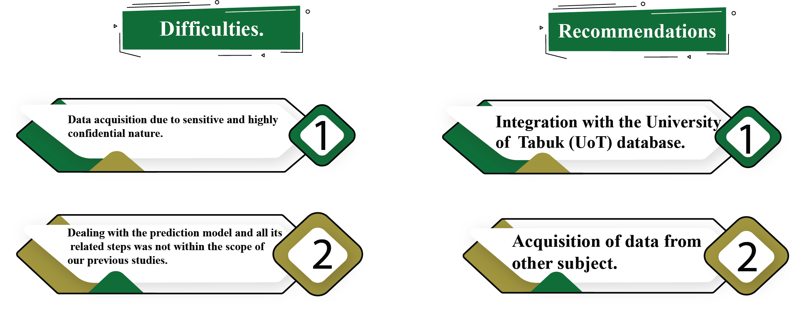

Recommendations and Difficulties.
6

Slide 9

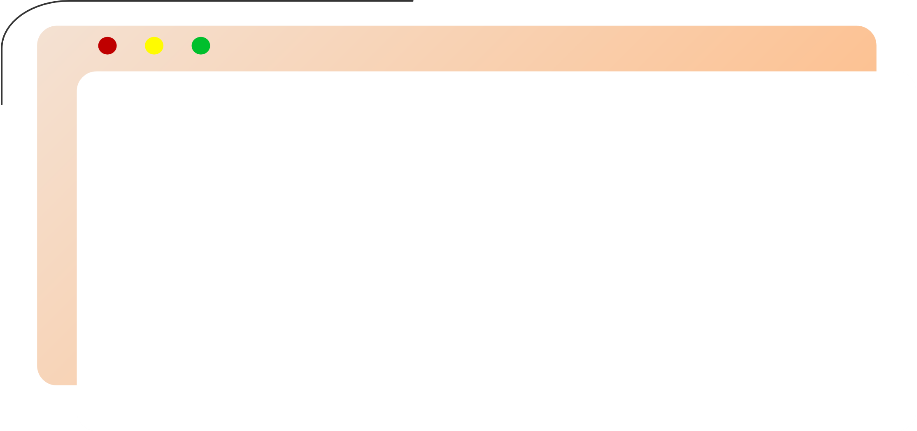
Conclusion
The project aimed to develop a web-based predictive model for evaluating Program Learning Outcomes (PLOs) attainment at University of Tabuk (UoT).
Utilizing predictive analytics to identify students at risk of poor performance in achieving learning outcomes.
The web-based system was developed following the Waterfall methodology.
The prediction model was built using standard methodologies in data science and artificial intelligence.
These efforts aimed to enhance academic achievements and prepare graduates for the labor market.
7

Slide 10


